Slide 2
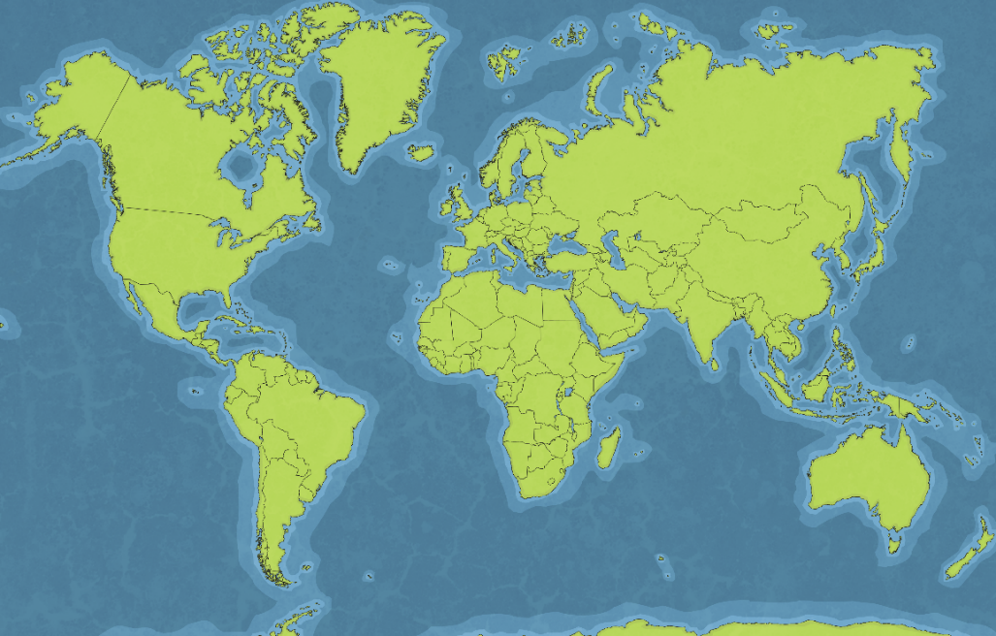
Can You Remember Where Rainforests Are Found?
Can you find each country?
1
Brazil
Peru
Indonesia
Bolivia
Ecuador
Guyana
India
Malaysia
Mexico
Venezuela
Australia
2
3
4
5
6
9
7
10
4
6
8
7
5
8
1
3
2
9
11
10
11

Slide 3
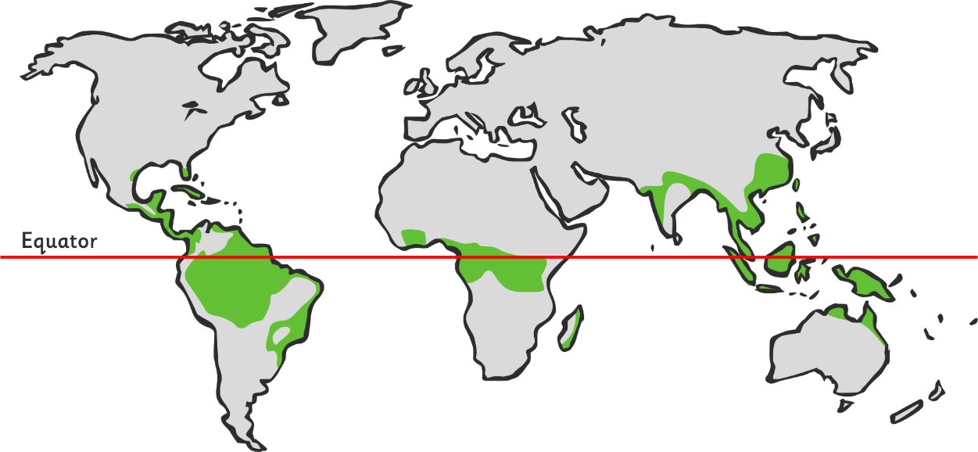
What Do You Notice?
What do you notice about the location of most rainforests?
What’s this line called?
Rainforests are found near to the equator.

Slide 4
What Do You Notice?
What do you notice about the location of most rainforests now? Can you describe their location even more precisely?
Tropics of Cancer
Tropics of Capricorn
Rainforests are found between the Tropics of Cancer and Capricorn.

Slide 5
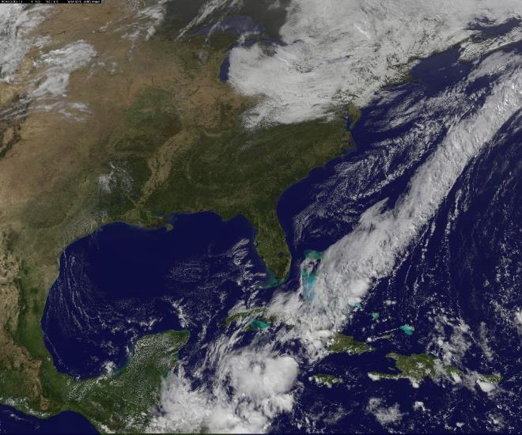
Climate and Weather
What is the difference between weather and climate?
Climate is the usual or average weather conditions over a long period of time.
Weather is the specific condition on a given day (which may or may not be typical for a climate).
Photo courtesy of gsfc @flickr.com - granted under creative commons licence - attribution

Slide 6
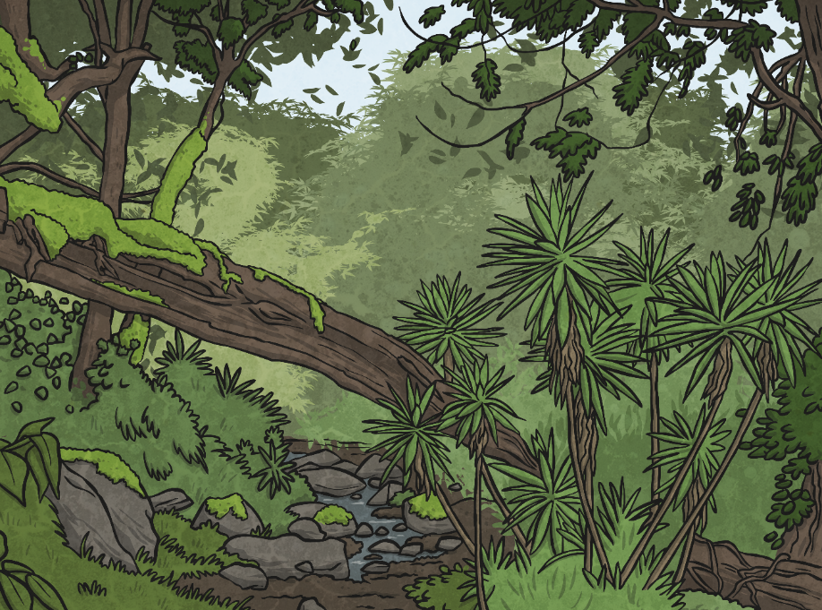
What Is the Climate of a Rainforest?
There are no seasons – the climate is the same all year round.
Every month has an average rainfall of at least 6cm.
It usually rains every day.
Temperatures are hot all year round.
It is very humid.

